Slide 1
Prediction of loan default is it possible to reduce the default rate?
Dipanjan Bandyopadhyay
June 2, 2018
Notes:
This template can be used as a starter file for presenting training materials in a group setting.
Sections
Sections can help to organize your slides or facilitate collaboration between multiple authors. On the Home tab under Slides, click Section, and then click Add Section.
Notes
Use the Notes pane for delivery notes or to provide additional details for the audience. You can see these notes in Presenter View during your presentation.
Keep in mind the font size (important for accessibility, visibility, videotaping, and online production)
Coordinated colors
Pay particular attention to the graphs, charts, and text boxes.
Consider that attendees will print in black and white or grayscale. Run a test print to make sure your colors work when printed in pure black and white and grayscale.
Graphics, tables, and graphs
Keep it simple: If possible, use consistent, non-distracting styles and colors.
Label all graphs and tables.

Slide 2
Prediction of Loan default
The problem
The dataset
The data story
Descriptive and inferential statistics
Machine learning algorithms to predict default
Conclusion
Notes:
Overall, what this presentation is about

Slide 3
The Problem
Loan defaults cause big losses for banks and financial institutions
It is hard to predict which customer will default
Customer data is available
Demographics
Payment behavior etc.
Can customer data be used to predict default?
Notes:
The problem statement

Slide 4
The Dataset
Payment behavior of credit card clients in Taiwan from April 2005 to September 2005
Data:
Demographics: Gender, Education, Marital Status, Age
History of past payments : 6 months
Amounts in Bill statements : 6 months
Past payments : 6 Months
Default status
Assumptions were made on some unexplained variables
Notes:
Description of the dataset being used in the project

Slide 5
The Data Story
The main goal of this investigation is to figure out, which variables among the 23 have higher impact in predicting probability of default next month. The project took a series of steps and explored data to figure out the impacts:
Notes:
What is the goal of the data story

Slide 6
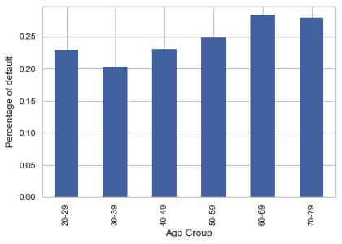
The Data Story Do Age have impact on default?
Higher default rate in 60-69 age group
The next two are 70-79 and 50-59
Notes:
Age

Slide 7
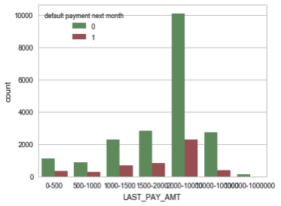
The Data Story Does the Last Bill payment amount have impact on default?
The default rate is interestingly higher when the last payment amount is low.
The default percentage is higher if the last payment amount is below 10,000
Notes:
Last Payment

Slide 8
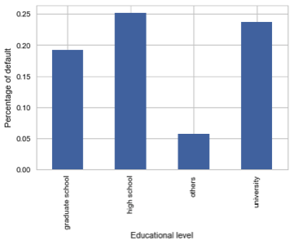
The Data Story Does Education have impact on default?
The less the educational level, more the default percentage.
Notes:
Education

Slide 9
The Data Story Does Marital status have impact on default?
‘Married’ people tend to default more than ‘Single’ folks.
Notes:
Marital status

Slide 10
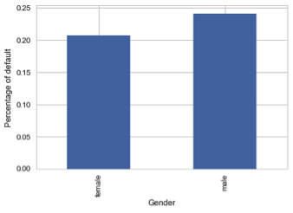
The Data Story Does Gender have impact on default?
Clearly, males tend to default more than females
Notes:
Gender

Slide 11
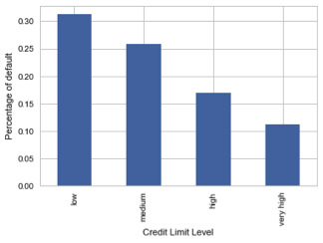
The Data Story Does Credit Limit have impact on default?
Card holders with lower credit credit limits tend to default more
Notes:
Credit limit

Slide 12
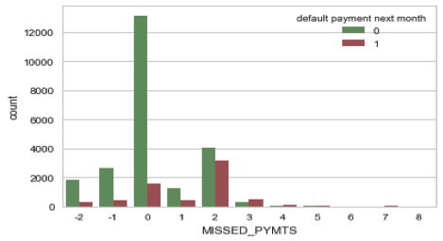
The Data Story Is missed payment a precursor to default?
It is evident that if there are two or more missed payments, the chance of default increases significantly
Notes:
Missed payments

Slide 13
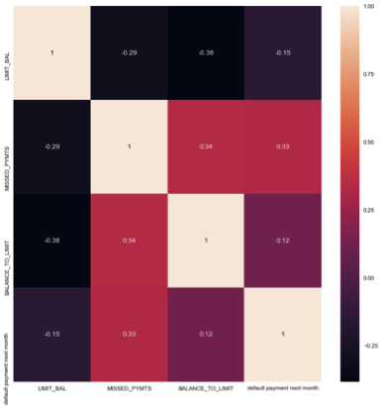
The Data Story Correlations
Missed payments has a positive correlation with default whereas Credit limit has a negative correlation with default
Notes:
Correlations

Slide 14
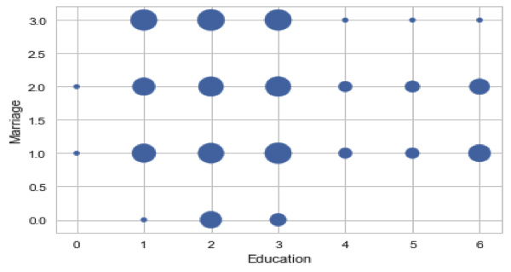
The Data Story Composite impact- Education + Marital status
Single with high school education shows higher rate of default.
Notes:
Composite

Slide 15
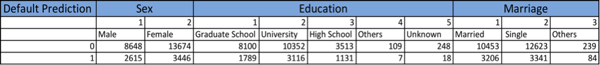
Descriptive and Inferential statistics
Summary Statistics
Notes:
Descriptive

Slide 16
Inferential Statistics
Two Sample t tests were conducted to figure out
Whether male default rate is significantly different from female default rate
Test Result : Yes, there is significant difference
Whether University educated and high school educated people have significant difference in default rates
Test Result : No, there is no significant difference
However at 95% confidence level, it appears that there is significant difference
Notes:
inferential

Slide 17
Inferential Statistics
A joint plot of credit limit and default was created
Results:
Credit limit and default are independent of each other
There is little bit of negative correlation between the two
Higher the credit limit, lower the chance of default
Notes:
Inferential

Slide 18
Machine learning algorithms
Logistic Regression
Logistic Regression was performed
Results:
Feature set : LIMIT_BAL','SEX','EDUCATION','MARRIAGE','AGE',
'PAY_0','PAY_2’,'PAY_3','PAY_4','PAY_5','PAY_6','DUE_1'
Training score: 0.777333333333 Testing score: 0.782222222222
Coefficients [[ -6.17570756e-06 -2.48807560e-04
-3.09325710e-04 -2.63706644e-04 -4.36734324e-03
3.28368937e-04 2.63650826e-04 2.32646107e-04
2.14305066e-04 2.02270811e-04 1.94074563e-04
3.56310401e-07]]
Intercept [-0.00014417]
Notes:
Logistic Regression

Slide 19
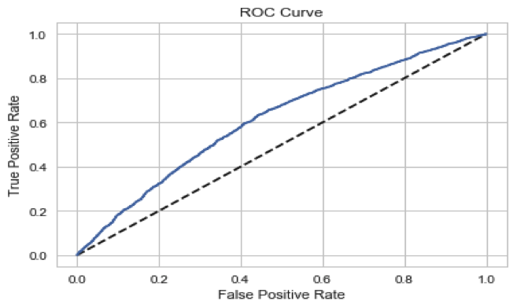
Machine learning algorithms
Logistic Regression
Notes:
Logistic Regression

Slide 20
Machine learning algorithms
KNN and Random Forest
K- Nearest Neighbor algorithm was used
Results:
Training score: 0.805904761905 Testing score: 0.739888888889
Random Forest algorithm was used
Results:
Training score: 0.978619047619 Testing score: 0.799333333333
Notes:
KNN and RF

Slide 21
Machine learning algorithms
Taking care of class imbalance
There is class imbalance in dataset with default = yes as the minority class
Random Forest algorithm was used with class_weight = ‘balanced’
Results:
Training score: 0.977857142857
Testing score: 0.802444444444
Notes:
KNN and RF

Slide 22
Conclusions
Our Machine learning algorithms can predict probability of default with 74% to 80% accuracy
If Banks and financial institutions follow some of the findings and recommendations of this project while choosing the demographics and credit limit of the customers; they can reduce default.
Notes:
Conclusion

Slide 23
HAPPY CREDIT !!!!!
Notes:
What is the goal of the data story

